Slide 1
Key Exchange Outside of TCP/IP
Andre C
Jack Potter
Jacob Moody
Joel Wacker
Jordan Svoboda
Logan Woolery
Advised by:
Dr. Julie Rursch
Notes:
Jack

Slide 2

Project Vision
Key exchange without TCP/IP
Implemented for secure communication.
No trust in networks
No trust in authorities
Different from existing platforms
Keys can’t be intercepted
Ciphers can’t be downgraded
User-centric privacy
Users only trust each other
Notes:
Moody

Slide 3
Target Audience
Privacy advocates
Journalists
Security Hobbyists
Anyone with privacy concerns
Notes:
Moody

Slide 4
Application Usage-
User Setup
Alice generates her keypair
Registers her pubkey
Bob generates his keypair
Registers his pubkey
Alice and Bob meet in person
Exchange pubkeys
Collaboratively generate symmetric key
Notes:
Logan

Slide 5
Application Usage - Messaging
Alice writes a message to Bob
Alice encrypts the message with the appropriate symmetric key
Alice appends Bob’s public key to the message
Alice signs the entire message with her private key
Alice uploads the signed message to the server
Bob polls the server for new messages associated with his pubkey
The server returns the message to Bob
Bob decrypts the message with the appropriate symmetric key
Notes:
Logan

Slide 6
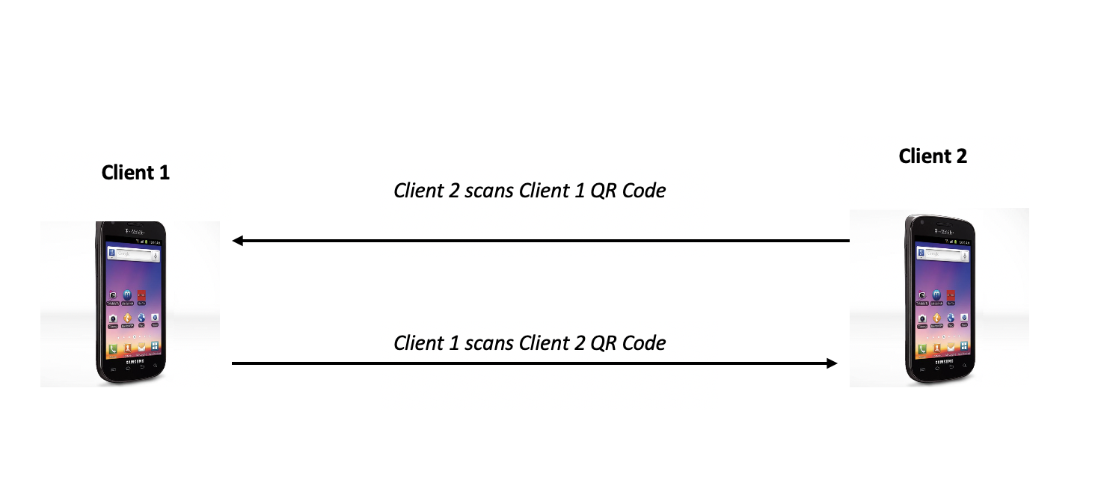
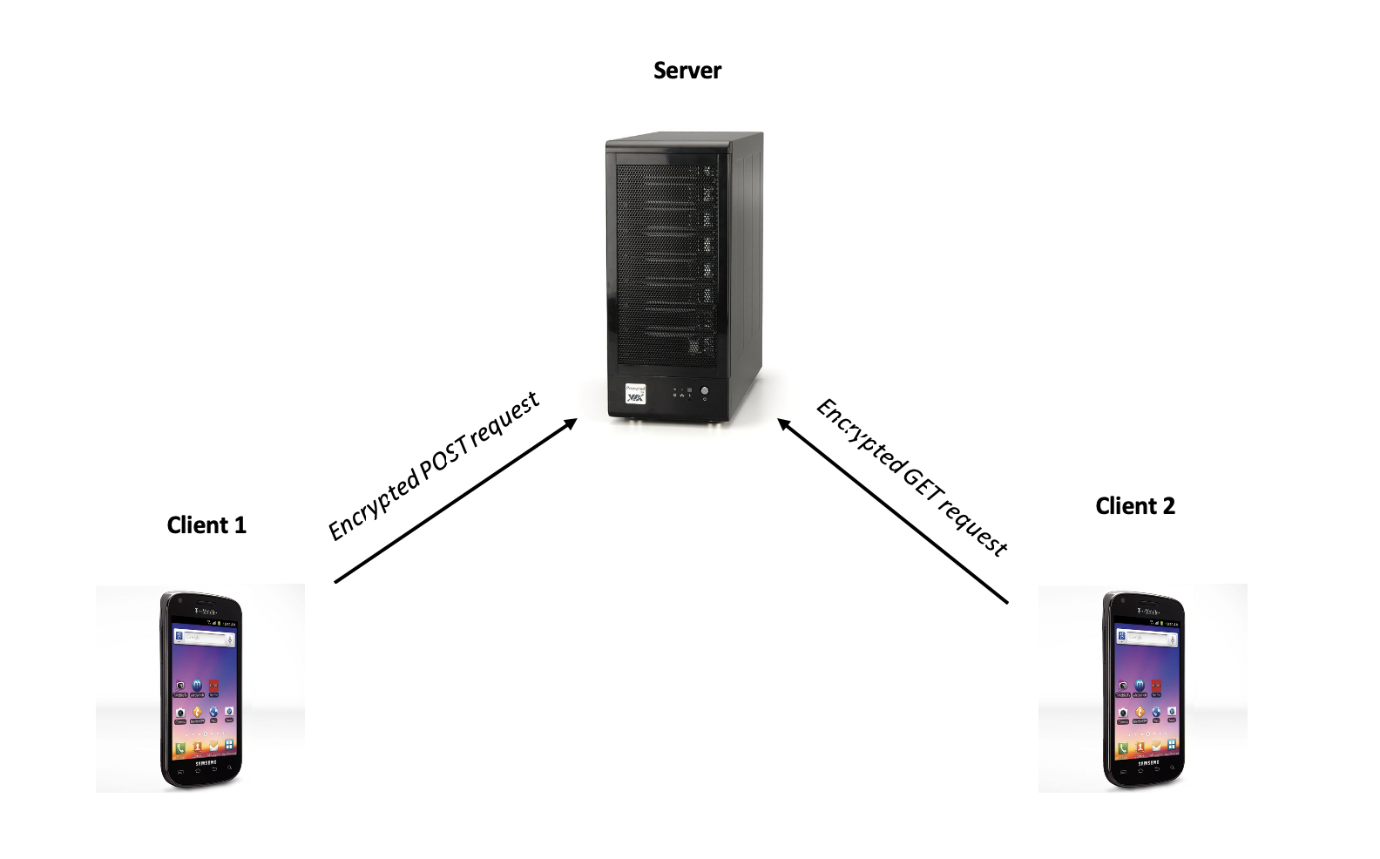
Visual of Communications
Clients Share Symmetric Keys Client/Server Communication
Notes:
Logan

Slide 7
Requirements
Notes:
Joel

Slide 8
Functional Requirements
Cross-platform
Android and iOS
Secure communication
Alice to Bob in setup
Alice sends to Server
Bob fetches from server
Secure random key generation
Server application logs nothing
Messages deleted from server according to user preferences
Notes:
Joel

Slide 9
Non-functional Requirements
Security
Third party can’t intercept/regenerate/
replay keys
Availability
No waiting on server to accept message
Speed
Small amount of
data → fast transmission
Usability
Simple/responsive UI
Notes:
Joel

Slide 10
Conceptual Design Diagram
Notes:
Andre

Slide 11
Project Plan
Notes:
Jack

Slide 12
Project Plan- Tasks
Android/iOS application development
Secure key generation
QR code sharing
Cross-platform functionality
Server development
RestAPI for clients
Message routing
Security Auditing and Testing
Verify CIA model
Conduct penetration and stress tests on server
Notes:
Jack

Slide 13
Project Plan- Risks and Mitigation
Eve attempts to download Bob’s messages
Require request to be signed with Bob’s private key
Messages still encrypted with Alice/Bob symmetric key
Server drive failures lead to messages being lost before delivery
RAID array or ZFS pool to ensure data integrity
Attempts to trick users into downloading malicious version of application
Encourage users to pay attention to checksums
Legal request for server contents (logs, users, messages)
No logging
No user information beyond public key
Messages can be configured to be deleted from server after delivery
Notes:
Jack

Slide 14
System Design
Notes:
Jordan

Slide 15
Technologies
Flutter
  Allows easy multi-platform client development
  Shared codebase for both iOS and Android
  Emulation and “Hot Reload” features
Go
  Server is written in Go
  Quick to get started with (Plenty of Libraries)
  Will scale well in terms of speed
Notes:
Jordan

Slide 16
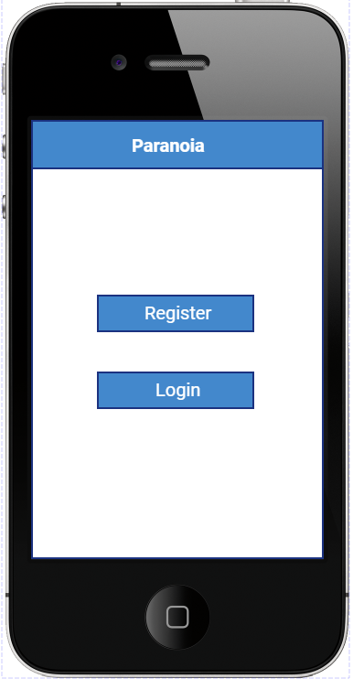
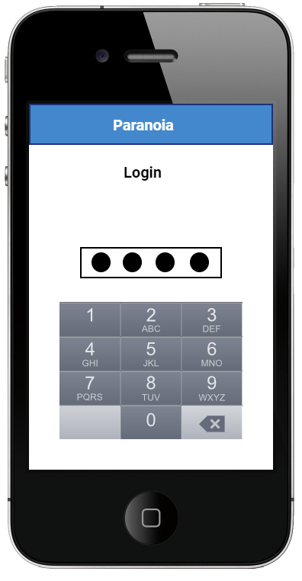
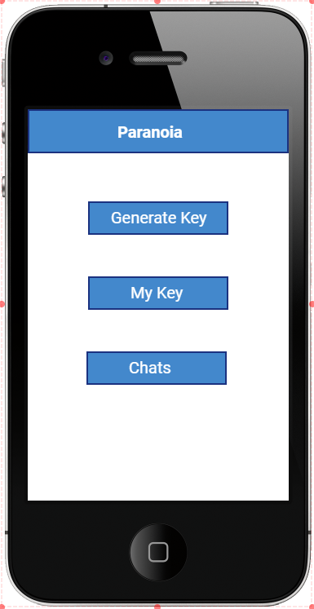
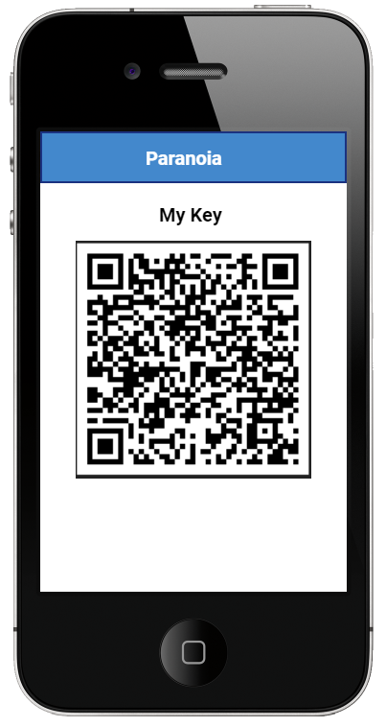
Some UI designs
Notes:
Jordan

Slide 17
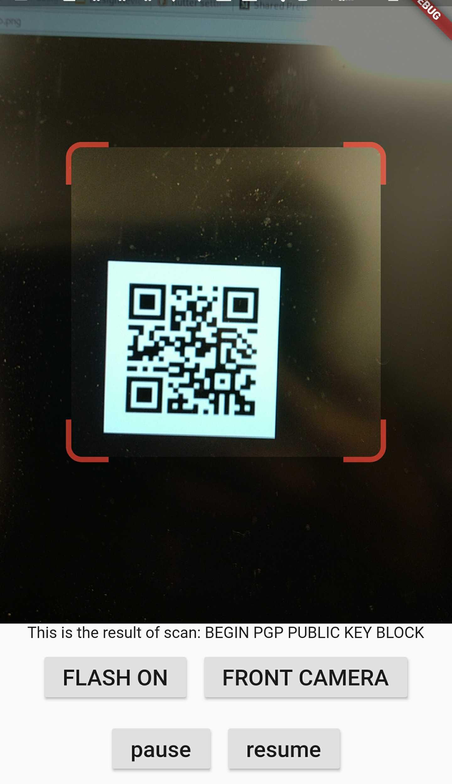
Prototype Implementations
Client Prototype:
QR Code reader
  Able to read small (under 1000 character) QR codes
Opens doors for other hardware interfaces (Audio, Bluetooth)
Notes:
Joel

Slide 18
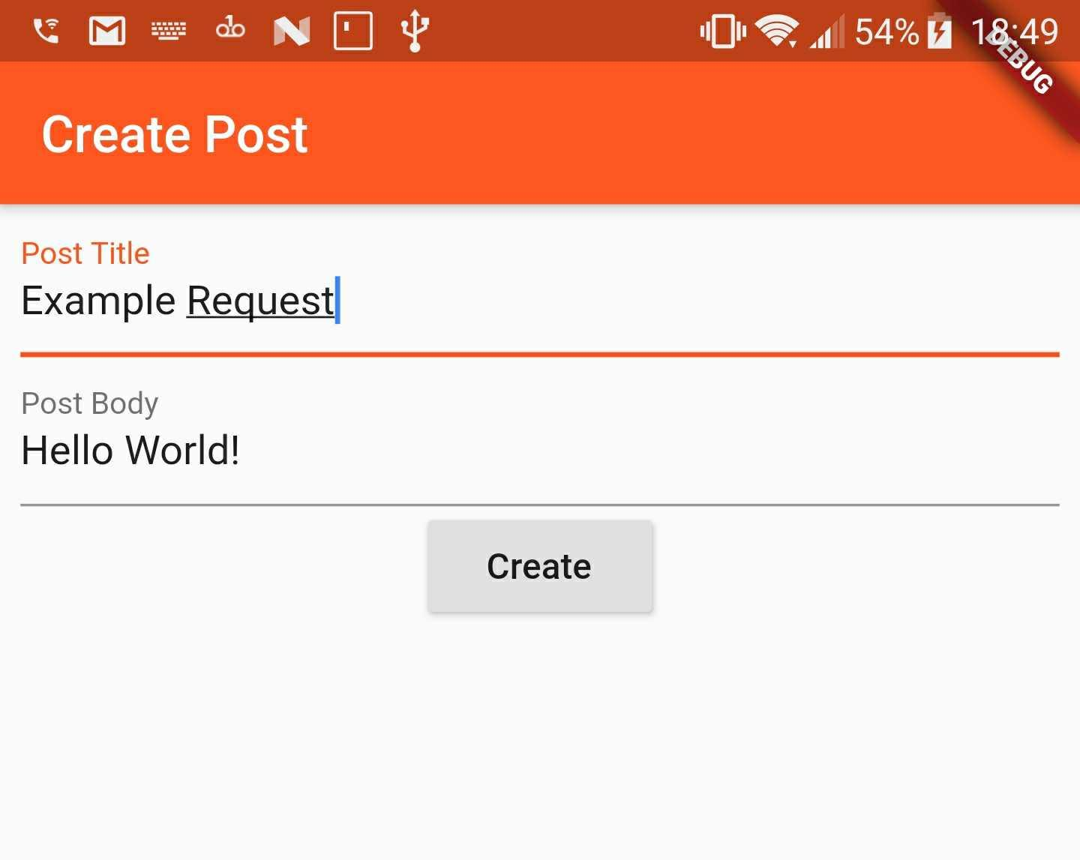
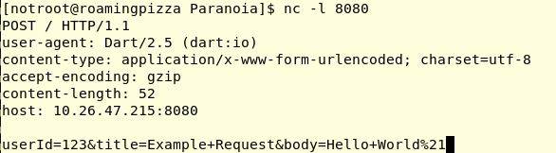
Prototype Implementations
Client Prototype:
Post Request functionality
  Able to send requests to a server
Notes:
Joel

Slide 19
Project Plan

Slide 20
Progress Metrics
We have designated the following tasks to be good metrics:
Functional cellphone application
  Generate public/private key pair
  Work with other device to generate symmetric key
  Encrypt/Decrypt messages locally
  Send messages to/Receive messages from server
Functional server
  Handle multiple incoming connections at once
  Store encrypted messages and public keys
Notes:
Logan

Slide 21
Project Milestones
12/06/2019: Working client prototype
1/18/2020: Successful message encryption
1/25/2020: Communication between two users
2/10/2020: Usable beta version of application
2/24/2020: Group chat fully functional
3/1/2020: All application functionality implemented
Notes:
Logan

Slide 22
Test Plan
Notes:
Andre

Slide 23
How will we test?
Client
Emulated iOS/Android phones
Actual Phones
Server
Development environment
Unit tests
Notes:
Andre

Slide 24
Functional Testing
Unit Testing
Performed on individual functions/new features
Integration Testing
Test that the new code works with the old
System Testing
Test that client/server behave as intended
Acceptance Testing
Give application to users to ensure most desired features are present
Notes:
Andre

Slide 25
Non-Functional Testing
Performance Testing
Get feedback on performance of application from users
Security Testing
Code review/penetration test performed on application
Usability Testing
Gather feedback from users on experience using application
Compatibility Testing
Test that application works on a number of platforms
Notes:
Andre

Slide 26
Conclusion
Current Phase
  Client key sharing via QR Codes
  Basic implementation of clients and server RestAPI for communication
Next semester’s milestones
  Implementation of client/client communication
  Message encryption/decryption
  Routing encrypted messages
Notes:
Moody

Slide 27
Individual Contributions
Jacob- Server development
Jack- Infrastructure configuration
Joel- QR code generation and receiving
Jordan- Client application development
Logan- Architectural design and Integration testing
Andre- Quality assurance testing for server and applications
Notes:
Moody

Slide 28
Acknowledgement
Thank you to Dr. Julie Rursch for advising us throughout this process!
Notes:
Jack

Slide 29
Questions?
More information: http://sdmay20-52.sd.ece.iastate.edu/
Source Code: https://github.com/SD-PARANOIA
Full design documentation: http://sdmay20-52.sd.ece.iastate.edu/docs/sdmay20-52_Design_DocumentFINAL_fall.pdf
Notes:
Jack

